Slide 1

图像滤镜

Slide 2

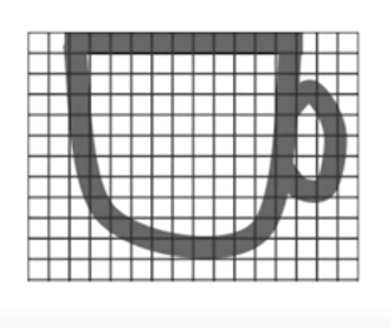
分辨率：16X12
12
16

Slide 3
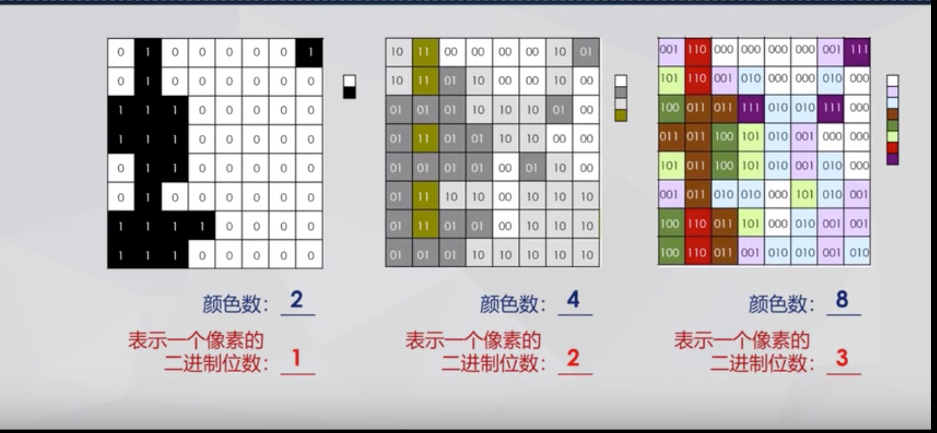

Slide 4
一个分辨率为16*16的16位位图占用多少字节？
1152
1024
512
以上答案均不对

Slide 5
一个分辨率为16*16的16色位图至少占用多少字节？
256
128
512
以上答案均不对

Slide 6
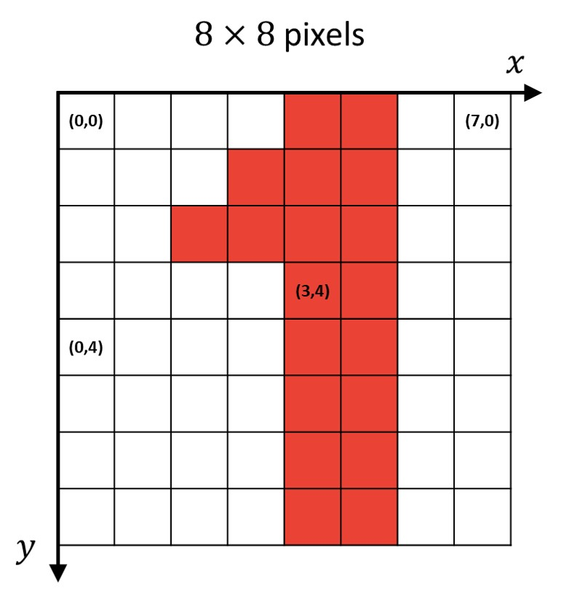

Slide 7
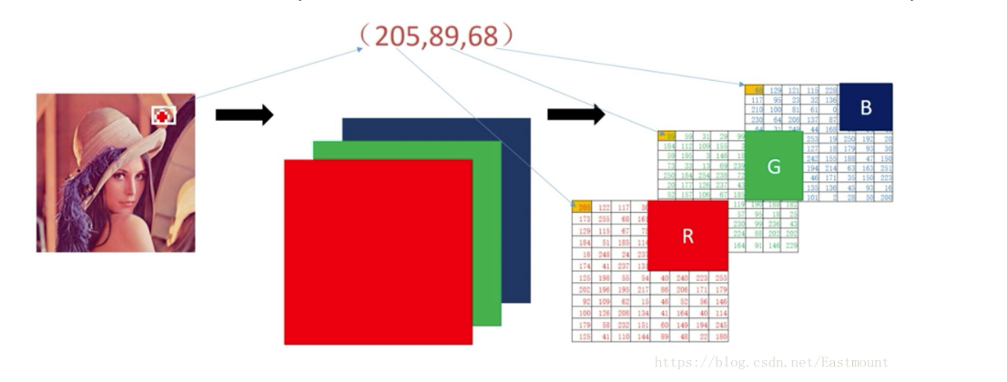

Slide 8
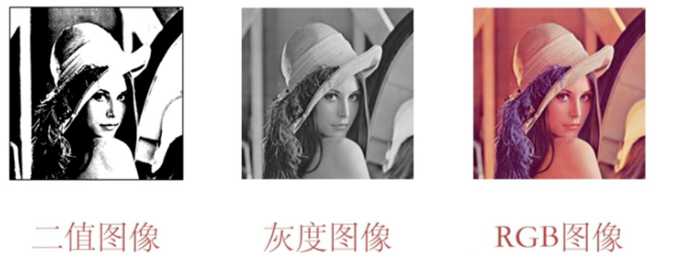
二值图像： 非黑即白，每一个像素要么是255，要么是0
灰度图像：除了黑与白，还有灰色。将灰度划分为256中不同的颜色。
彩色图像： RGB图像

Slide 9
import cv2 #import opencv library img = cv2.imread(‘paris.jpeg‘) #read image img_width= img.shape[1] #width of image img_height= img.shape[0] #height of image print(img_width, img_height)
cv2.imshow("Demo", img) #show image cv2.waitKey(0) #wait forever

Slide 10
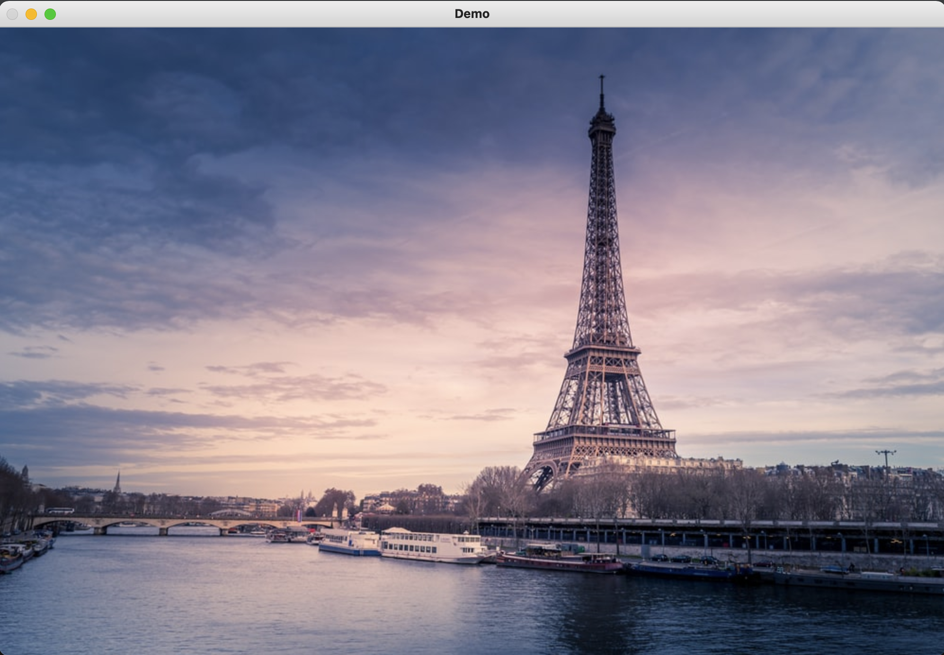
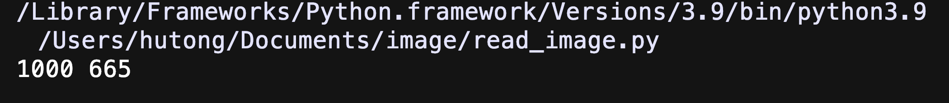
import cv2 img = cv2.imread('paris.jpeg') img_width= img.shape[1] img_height= img.shape[0] print(img_width, img_height)
cv2.imshow("Demo", img) cv2.waitKey(0)

Slide 11
import cv2 img = cv2.imread('paris.jpeg') img_width= img.shape[1] img_height= img.shape[0] print(img_width, img_height)
cv2.imshow("Demo", img) cv2.waitKey(0)
if k==27: cv2.destroyAllWindows() #press Esc to close image

Slide 12
blue = img[100, 200, 0] green = img[100, 200, 1] red = img[100,200,2] print(blue, green, red)

Slide 13
200
0
blue = img[100, 200, 0] green = img[100, 200, 1] red = img[100,200,2] print(blue, green, red)
100
121 80 55

Slide 14
200
0
blue = img[100, 200, 0] green = img[100, 200, 1] red = img[100,200,2] img[100,200,2] = 255
100
121 80 255

Slide 15
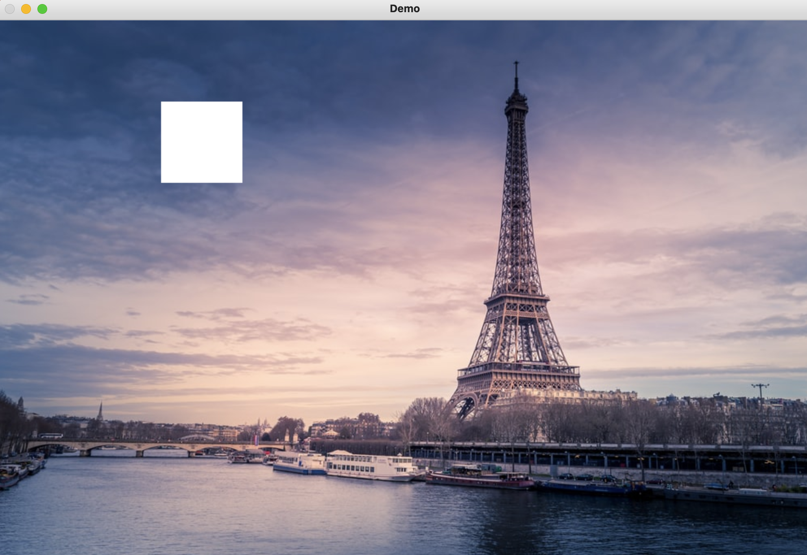
200
0
blue = img[100, 200, 0] green = img[100, 200, 1] red = img[100,200,2] img[100:200,200:300]
=[255, 255, 255]
100
255, 255, 255

Slide 16
200
0
blue = img[100, 200, 0] green = img[100, 200, 1] red = img[100,200,2] img[100:200,200:300]
=[255, 255, 255]
100
255, 255, 255

Slide 17
for row in range(img_height): for col in range(img_width): blue = img[row, col, 0] green = img[row, col, 1] red = img[row, col, 2] red = blue img[row, col] = [blue, green, red]

Slide 18
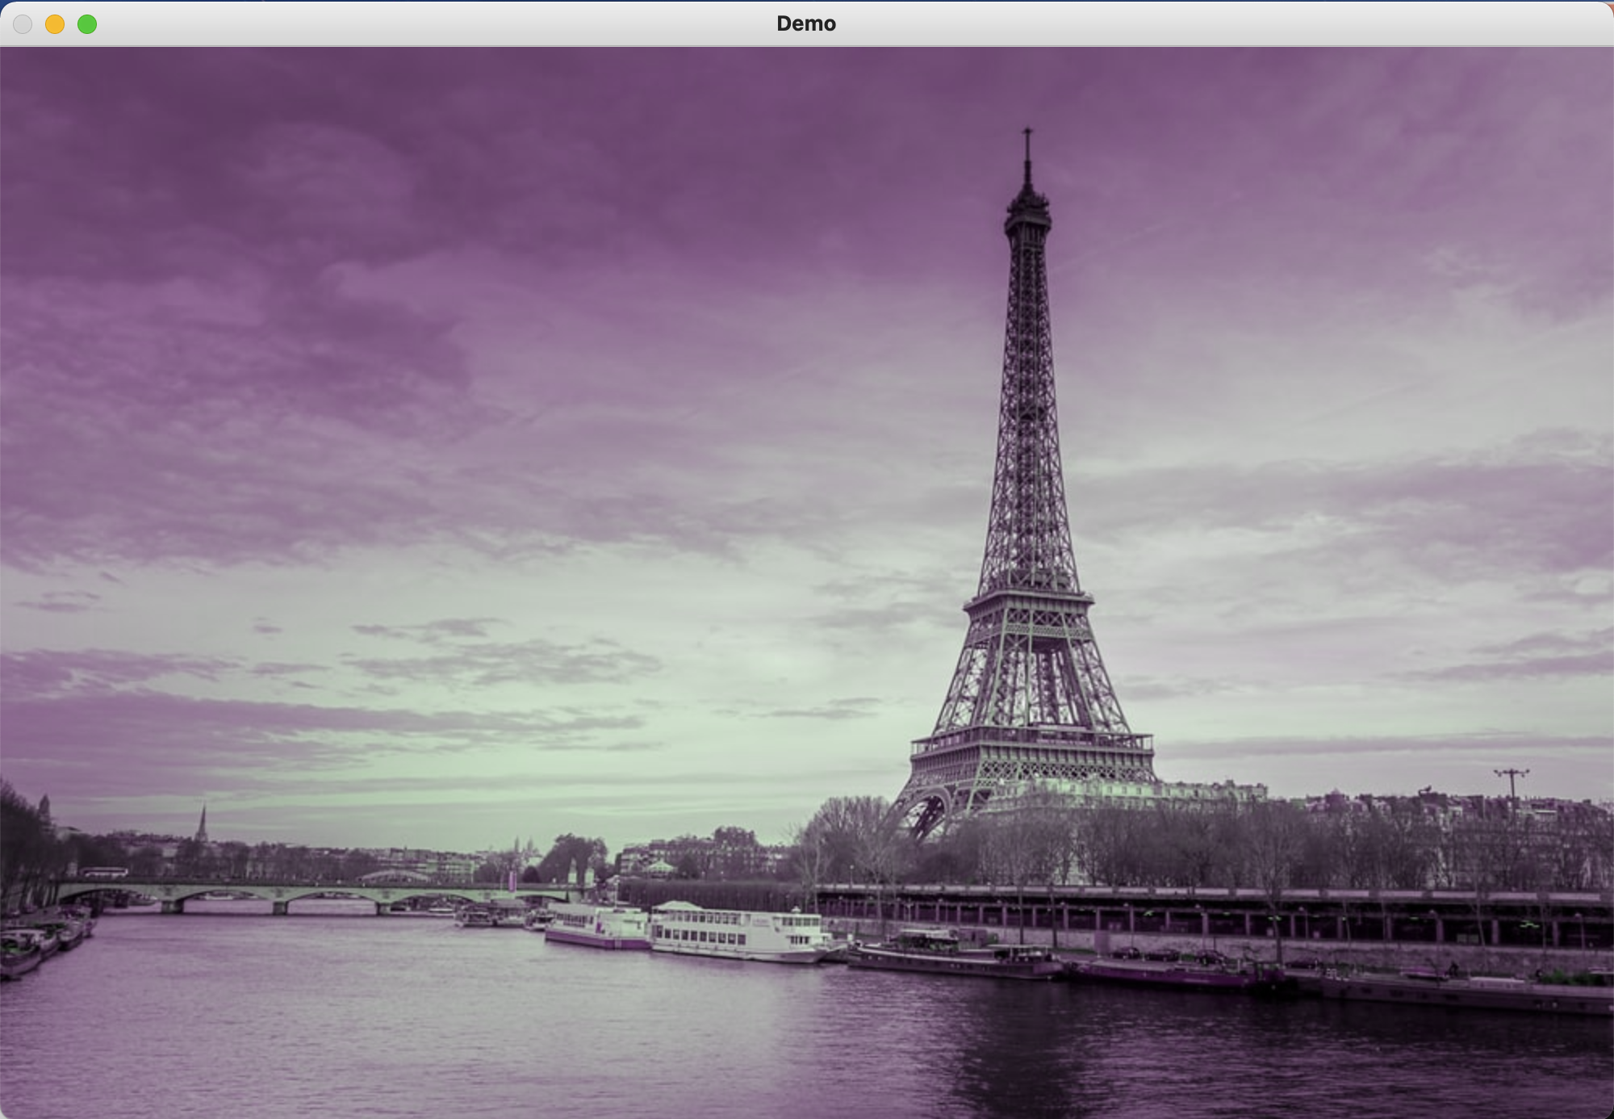
for row in range(img_height): for col in range(img_width): blue = img[row, col, 0] green = img[row, col, 1] red = img[row, col, 2] red = blue img[row, col] =
[blue, green, red]

Slide 19
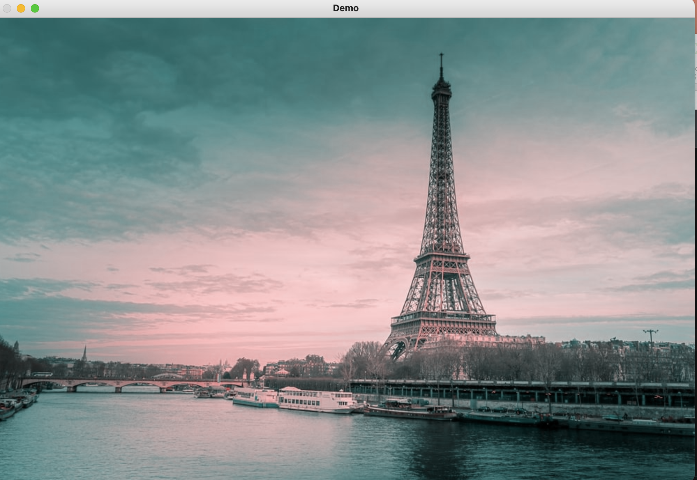

Slide 20
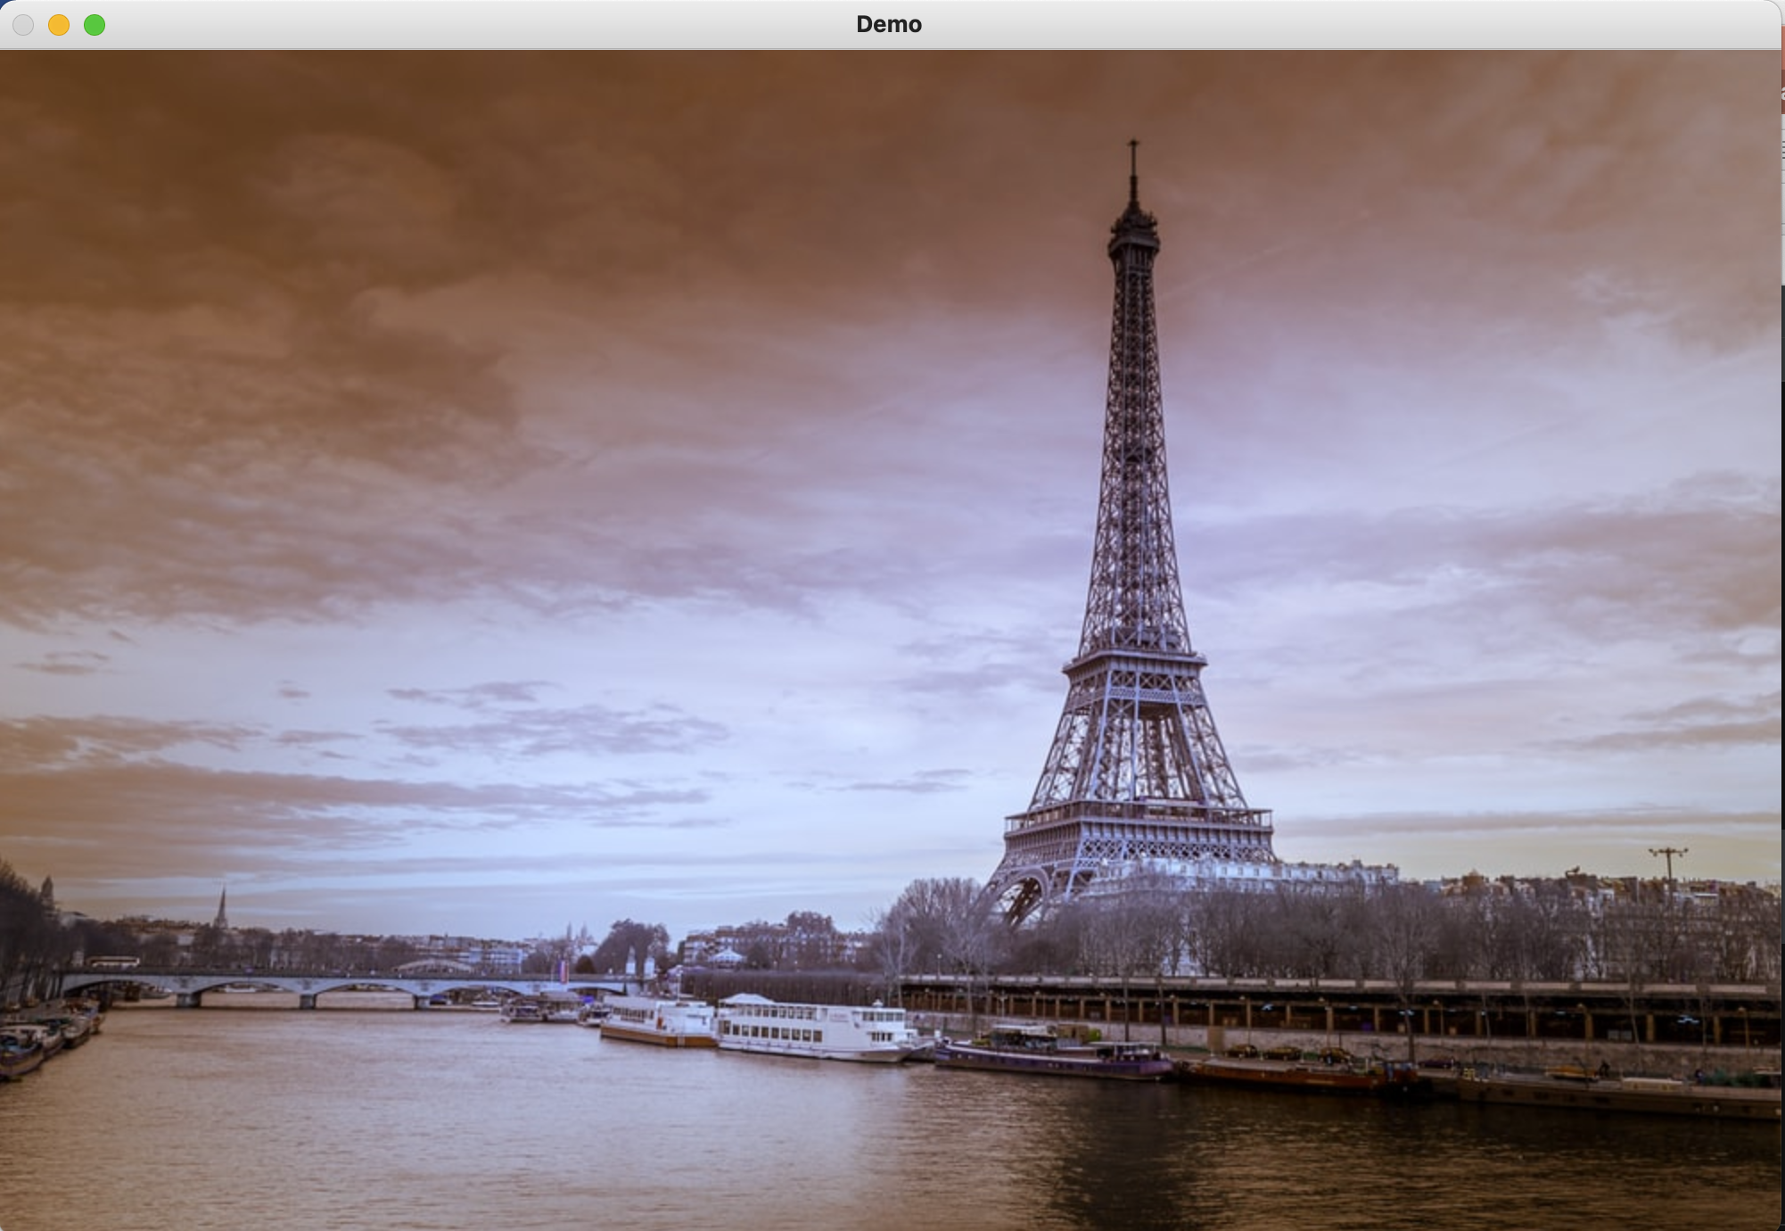

Slide 21
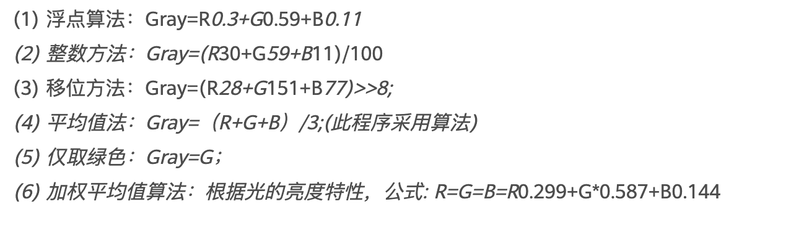
常见灰度算法

Slide 22
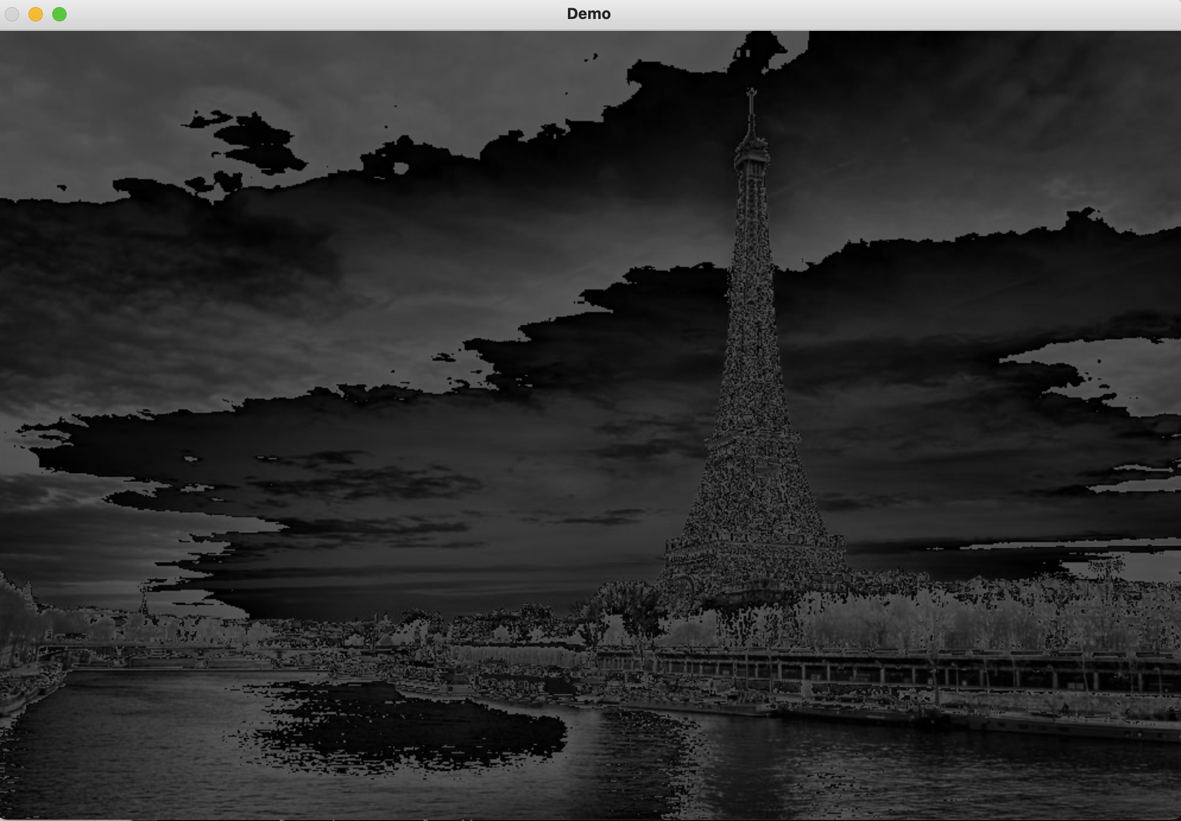
for row in range(img_height): for col in range(img_width): blue = img[row, col, 0] green = img[row, col, 1] red = img[row, col, 2] color = (blue+green+red)/3 img[row, col] =
[color, color, color]

Slide 23
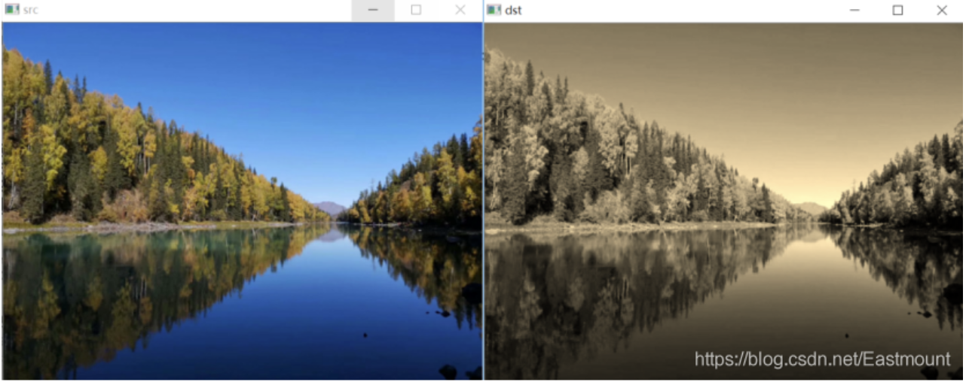
怀旧特效

Slide 24
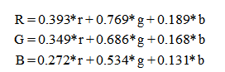
怀旧特效

Slide 25
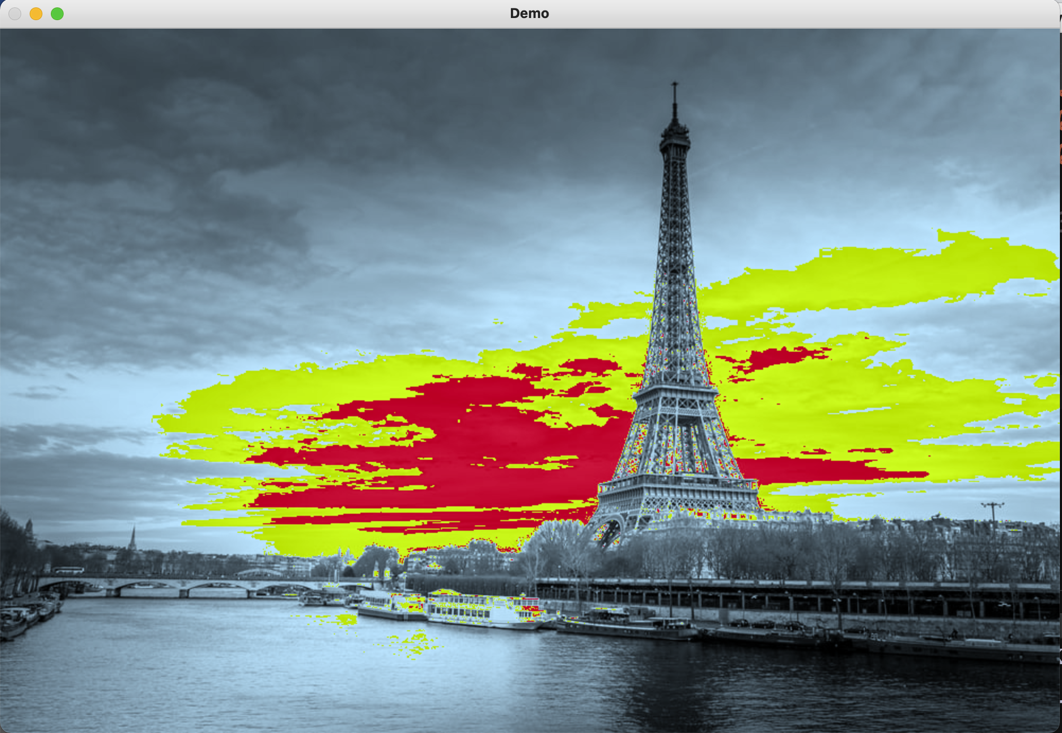
怀旧特效

Slide 26
THAT’S ALL FOR TODAY

